Slide 1
TCP Protocol
CS 117 Winter 2012
Mario Gerla
Layer
Lect 3

Slide 2
TCP Congestion Control
End to end approach to congestion control
No explicit feedback from network layer
TCP relies on perceived network congestion and adjusts its window accordingly.
TCP congestion control goal:
connection throughput = fair share of the available bandwidth
Challenge: enforcing fair share without knowledge of the connections that share the bottleneck

Slide 3
TCP Congestion Control (Cont.)
Receiver Window: also known as the Advertised Window (awnd) used by receiver to advertise the available buffers
Congestion Window (cwnd): its value depends on the network congestion as perceived by the TCP sender
TCP sender window is min (awnd,cwnd)

Slide 4
TCP Sender cwnd dynamics
Cwnd :
  increased by sender when it can handle higher rate,
  decreased when a segment is lost
Congestion “states” of a TCP sender:
  Slow Start state: initially, cwnd = MSS ; cwnd is then increased by 1 MSS for each timely ACK (thus sender starts slowly but accelerates exponentially!)
  Congestion Avoidance state: once cwnd exceeds a threshold, its rate of increase must be reduced; cwnd is increased by 1 MSS after each RTT (instead of each ACK), ie “linear” increase
Window (and TCP transmission rate) cannot increase indefinitely: at some point, packet loss and timeout will occur.
At timeout: threshold reduced by half and cwnd = 1 MSS (SlowStart)

Slide 5
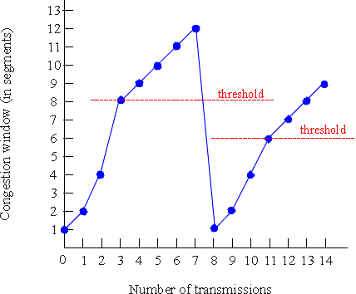
Congestion Window vs Time

Slide 6
Basic TCP Congestion Control TCP Tahoe
Initialize:
  cwnd <-- 1 (MSS);
  Threshold <-- 8 (MSS)
  State <-- Slow Start;
Case of:
  ACK received in Slow Start:
    cwnd <-- cwnd +1; /* “exponential ” increase of cwnd */
    If cwnd > Threshold Then State= Congestion Avoidance;
  ACK received in Congestion Avoidance:
    If # Acks received = cwnd Then cwnd <-- cwnd +1; /* “linear” increase of cwnd */
  Timeout:
    Threshold <-- cwnd/2;
    cwnd <-- 1;
    State <-- Slow Start;

Slide 7
TCP Improvements
TCP Reno:
Fast Retransmit: upon reception of third duplicate ACK (for same segment), retransmit the segment immediately;
Fast Recovery: after Fast Retx, set SSthreshold <= CWND/2
set CWND <= CWND/2 ; (no Slow Start!)

Slide 8
Open Issues in TCP Congestion Control
UDP traffic is not subject to TCP congestion control
some UDP sources (eg, IP telephony) may abuse this privilege to force buffer overflow and thus slow start on competing TCP connection (they are TCP-unfriendly!)
some applications (eg HTTP) can open several TCP sessions in parallel, thus getting an unfair advantage;
TCP reacts to packet loss as if it were always caused by congestion (ie, buffer overflow); if loss caused by random errors is prevalent, as in wireless links, TCP performance is poor

Slide 9
TCP Westwood:
Efficient Transport for High-speed wired/wireless Networks

Slide 10
TCP Westwood (Mobicom 2001)
Key Idea:
Enhance congestion control via the Rate Estimate (RE)
  Estimate is computed at the sender by sampling and exponential filtering of the ACKs
  Samples are determined from ACK inter-arrival times and info in ACKs regarding amounts of bytes delivered
RE is used by sender to properly set cwnd and ssthresh after packet loss (indicated by 3 DUPACKs, or Timeout)

Slide 11

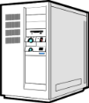
Rate Estimation
Bottleneck
packets
Receiver
Sender
ACKs
measure
Internet
Ideally, we would like to determine the connection fair share of the bottleneck bandwidth
Since fair share is difficult (to define or determine), we instead estimate the achieved rate: Rate Estimate (RE)

Slide 12

Rate estimation
3. TCP Westwood
d_{k}
t_{k-1}
t_{k}
Rate Estimate (RE) :
  Computed from the times when the ACKs come back to the sender

Slide 13
TCP Westwood: the control algorithm
TCPW Algorithm Outline:
  When three duplicate ACKs are detected:
    set ssthresh=RE*RTTmin (instead of ssthresh=cwin/2 as in Reno)
    if (cwin > ssthresh) set cwin=ssthresh
  When a TIMEOUT expires:
    set ssthresh=RE*RTTmin (instead of ssthresh=cwnd/2 as in Reno) and cwin=1
    Note: RTTmin = min round trip delay experienced by the connection

Slide 14
TCPW and random loss
Reno overreacts to random loss (cwin cut by half)
TCPW less sensitive to random loss
  (1) a small fraction of “randomly” lost packets minimally impacts the rate estimate RE
  (2) Thus, cwin = RE x RTT remains unchanged

Slide 15
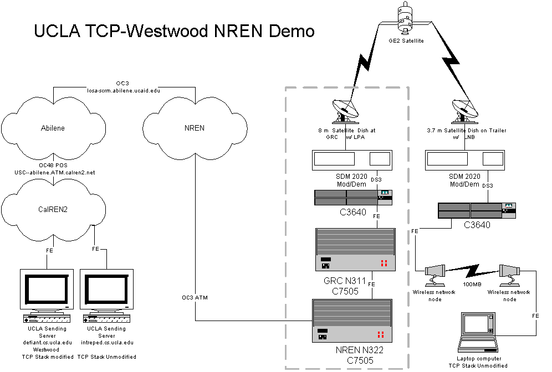
3. TCP Westwood
NASA Workshop Demo
(From Steve Schultz, NASA, 2000)
Internet Throughput Measurement

Slide 16
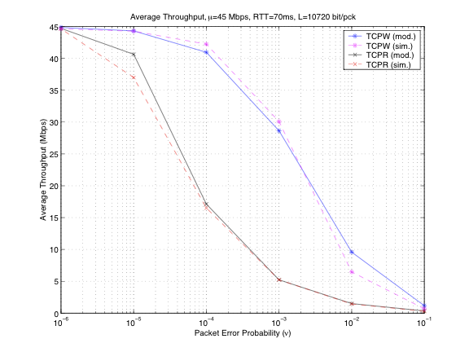
TCPW in presence of random loss: Analysis and Simulation

Slide 17
802.11 Lab - TCP/UDP performance
TCP/UDP performance over 802.11b Wireless LAN in presence of other devices and noise sources.

Slide 18
802.11Lab (cont)
    Measure TCP/UDP data throughput using Iperf measurement tool at different locations in Boelter Hall.
    Measure TCP/UDP data throughput in Lab with and without microwave turned on.
    Measure TCP/UDP data throughput in Lab with a Bluetooth personal-area network turned on.
    Measure TCP/UDP data throughput in Lab with a 2.4 GHz cordless phone operating (time permitting).

Slide 19
802.11 Lab (cont)
Specific experiments:
Plot TCP throughput vs. SNR (TCP throughput in Kbps on y-axis and SNR in dB on x-axis).
Explain your results. Is decrease in throughput linear with decrease in SNR? If not, why not?
Compare TCP throughput with the UDP throughput at the same points
etc

